Slide 1
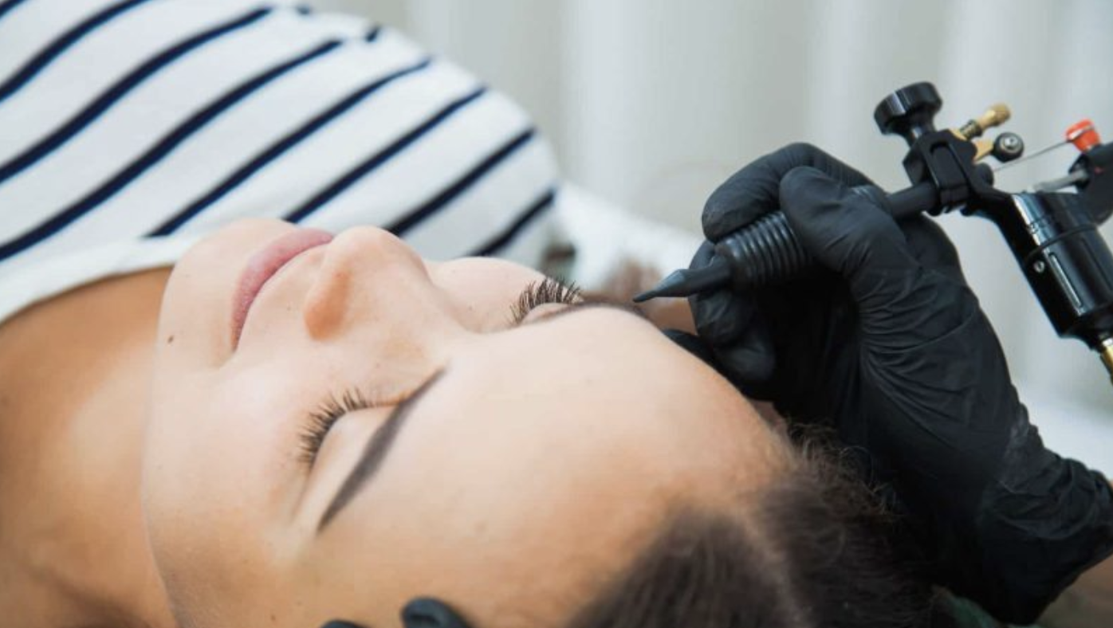
Unsupervised Learning: Unveiling Latent Consumers in Permanent Makeup
An Unsupervised Learning Approach to Exploring Different Consumer Personas

Slide 2
Overview
Problem: Use unsupervised learning to simulate and unveil non-obvious potential target groups for permanent makeup
Potential market barriers: financial cost, pain, socio-cultural stigma, permanence, or skepticism
Explore the traits of potential consumers by analyzing their personalities, risk aversion, values, and influencer trust that goes beyond demographics

Slide 3
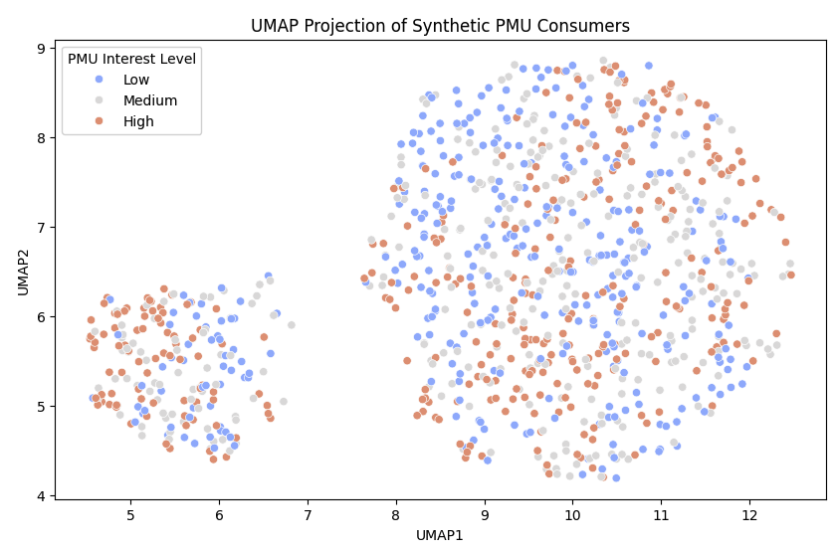
Data Creation & Preprocessing
Build synthetic data (1000 consumers) that includes demographic, psychological, behavioral, cultural and motivational factors
Data preparation for clustering and visualization
Normalize numeric features using StandarScaler
Use one-hot encode categorical features
Dimensionality reduction using PCA and UMAP for better local structure

Slide 4
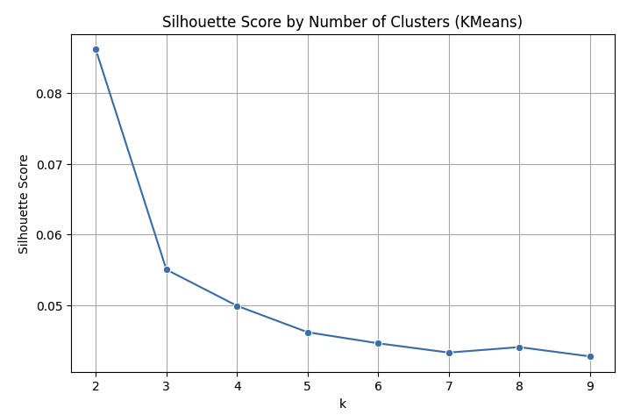
Data Creation & Preprocessing
Silhouette Score
Peak at k=2 (approx 0.088 score), the optimal number of clusters
Two clusters are the most naturally separated and compact in the synthetic data
Adding more clusters beyond 2 decreases the score

Slide 5
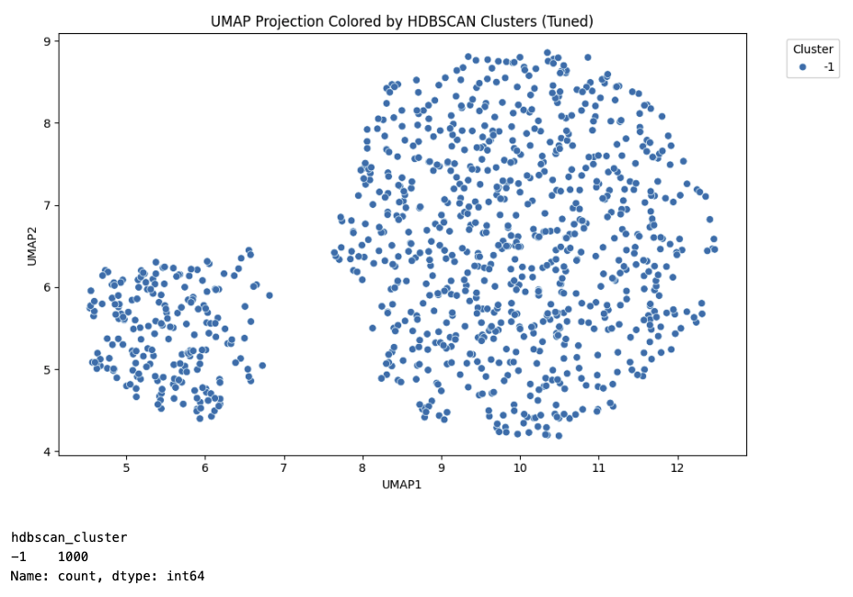
Data Creation & Preprocessing
HDBSCAN
Every point was labeled as noise (-1)
No clusters found despite loose parameters
Synthetic data is evenly distributed (no dense clusters)
UMAP clusters ≠ HDBSCAN clusters — visual separation ≠ density-based separability
Silhouette score and UMAP plots confirm that K-Means is more appropriate
Use K-Means with k=2 as core unsupervised method
Clustering Evaluation
Measure the following:
Silhouette score - cluster compactness and separation
Davies-Bouldin Index - intra-cluster similarity and inter-cluster differences

Slide 6
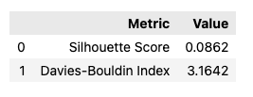
Data Creation & Preprocessing
Silhouette Score
Positive but low
Clusters are not strong in structure, but they're somewhat distinct and have some overlap between them
Davies-Bouldin Index
Score of 3.1642 shows:
Moderate internal spread
Overlap or proximity between clusters
Suggests that the archetypes likely have subtle differences
Insights:
Clusters are soft, but the visual separation in UMAP does show meaningful distinctions
Focus on behavioral patterns rather than fixed types since these are soft personas

Slide 7
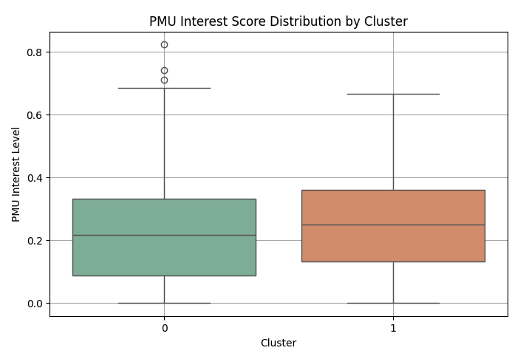
Consumer Persona
Cluster 0: Cautious Consumer
Cluster 1: Curious Consumer

Slide 8
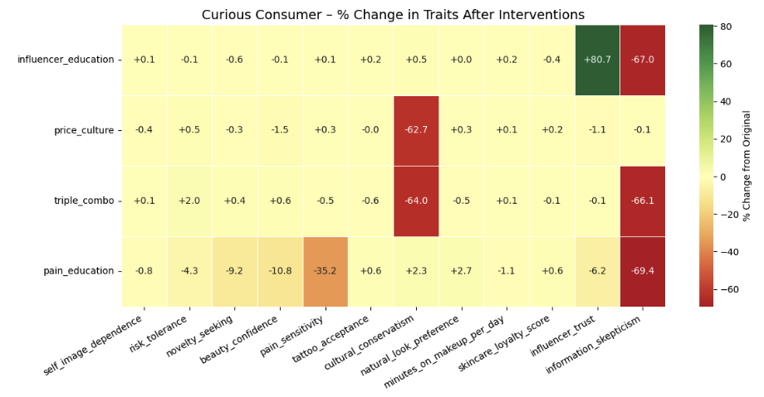
Simulate Interventions

Slide 9
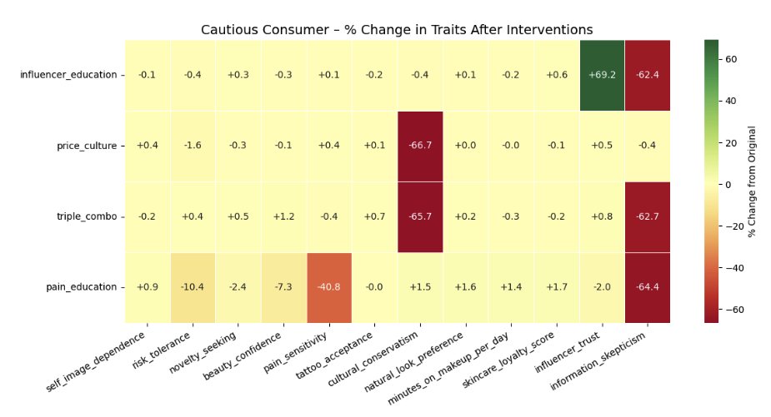
Simulate Interventions

Slide 10
Consumer Profile - Cautious Consumer
Pre-Intervention Personality Traits
Low risk tolerance
High pain sensitivity
Moderate self-image dependence
Conservative cultural views
Low influencer trust, high information skepticism
Best Interventions
Influencer Education: Reduces skepticism, raises trust (+69%)
Price + Cultural Shift: Dismantles cultural barriers (↓66% conservatism)
Pain + Education: Lowers fear (↓41% pain sensitivity), builds loyalty

Slide 11
Consumer Profile - Curious Consumer
Pre-Intervention Personality Traits
Moderate risk tolerance
Medium-high novelty seeking
Lower influencer trust, but open-minded
Low tattoo acceptance, image-dependent
Best Interventions
Influencer Education: Builds social confidence (+80% trust, ↓67% skepticism)
Triple Combo: Dismantles ideology & hesitation (↓66% conservatism)
Pain + Education: Boosts aesthetic preference and lowers resistance

